Slide 1
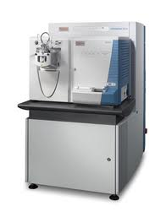
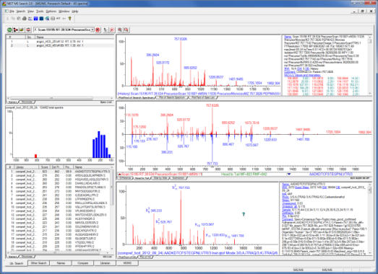
Peptide Mass Spectral Libraries
Biomedical and Health
Need
Proteomics is a major technology for profiling proteins in biological samples
Current practice identifies peptide tandem mass spectra (tryptic digests of proteins) by matching to theoretical peak masses
Objectives
Empirical spectra are culled from internal and external sources and used to compile ‘consensus’ and ‘best replicate’ reference spectra enabling more robust identifications
Achievements and Impact
The current human library, used on commercial platforms, contains reference spectra for >180,000 unique peptides, covering ≈ 20 % of the proteome
Metrics tools have already been commercialized by proteomics software vendors such as Proteome Software
Libraries under adoption for commercial use by Thermo Scientific’s Bioworks’ software for proteomics analysis
Peptide MS Library Workflow
MS/MS
trypsin
HPLC
proteins
peptides
Matching
Measured
Reference
Theoretical (good)
Library (better)
NIST MS Search (for peptides)
Customers and Partners
Notes:
Slide Note Sections:
Alternate Program Areas:
Talking Points: Major developments have also taken place in our LC/MS measurement program that will serve to enable both metabolomics and proteomics researchers to reliably identify these ubiquitous components of biological fluids. A single protein digest library program has also been created for use in quality control in proteomics. This resource, combined with NIST quality metrics for LC-MS, under concurrent development, is now available through the web on http://peptide.nist.gov and will serve as a basis for future quality control metrics. In addition, a new glycan and glycopeptides analysis system has been developed for characterizing 'biologic' drugs as part of our collaborative efforts within the biomanufacturing program at NIST. Methods to be used for creating spectra libraries for such chemical entities have already been developed for our QTOF instrument.
As part of a major inter-laboratory program supported the National Cancer Institute of the National Institutes for Health, we have been involved in the development of quality metrics for examining variability in mass spectra data between and within participating labs using standard NIST-prepared mixtures. This has led to the publication of a paper and the release of the metrics software, which has already implemented in commercial software. This work has been highlighted by NIH as a key accomplishment at the 2010 annual conference organized by the Clinical Proteomic Technology Assessment for Cancer program (CPTAC).
Descriptions of figures: Workflow of MS Library generation; Snapshot of website with NIST Libraries for Peptide Tandem Mass Spectra.
Contact: Paul Rudnick, 645
LIST OF CUSTOMERS AND PARTNERS:
College of American Pathologists
Proteome Software
National Cancer Institute
National Institutes of Health
References:
"Measuring Variability in Shotgun Proteomics Experiments”, Stein, S.E.; ASMS (2008)
“A Multi-site Assessment of Precision and Reproducibility of Multiple Reaction Monitoring-based of Protein Plasma”, Addona, T.A., et. al., Nature Biotechnology, vol. 27, issue 7, pp. 633-644, (2009)
“Depletion of Abundant Plasma Proteins and Limitations of Plasma Proteomics“, Tu, C.; Rudnick, P. A.; Martinez, M. Y.; Cheek, K. L.; Stein, S. E.; Slebos, R. J.; Liebler, D. C.; J. Proteome Research, vol. 9, issue 10, pp. 4982-4991, (2010)
“Performance Metrics for Liquid Chromatography-Tandem Mass Spectrometry Systems in Proteomics Analyses“, Rudnick, P.A., et al.; Mol. Cell Proteomics, vol. 9, issue 2, pp. 225-241 (2010).
Date: July 26, 2013

